Slide 1
The slackening orchestra music signaled the entrance of the ballerinas.

Slide 2
The crowd surged forward as Mark Zuckerberg threw hundred dollar bills off of the stage.

Slide 3
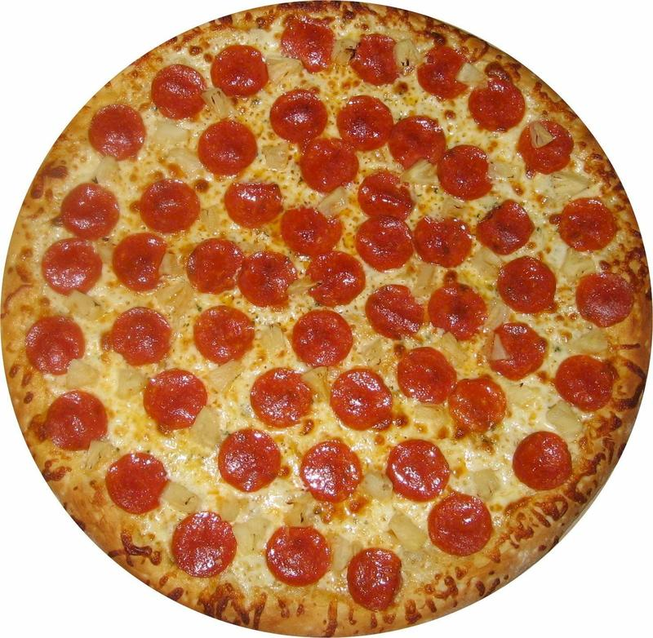
The 7th graders ran tumultuously to the cafeteria on Pizza Friday.

Slide 4
The mouse blinked his eyes several times when he emerged from the cave after hours of sunlight deprivation.

Slide 5
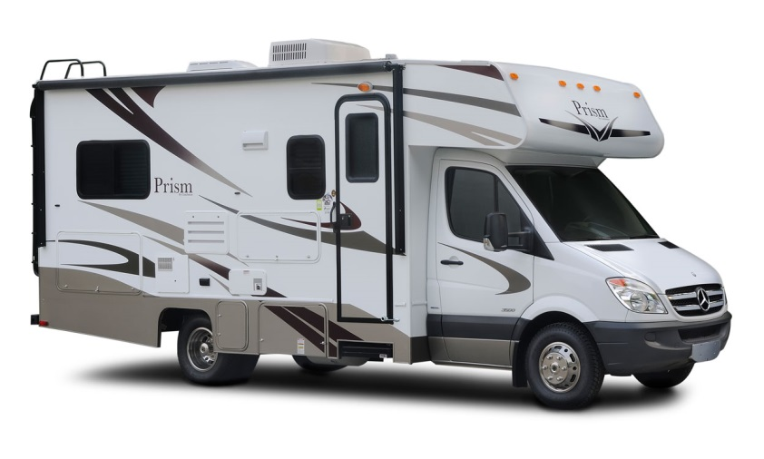
Some people like to travel in RV’s, but the confinement of so little space would make me claustrophobic.

Slide 6
Her maniacal devotion to Hello Kitty paints her life in pink, white, and black.

